Slide 1

Dog Tag Buddies
Web Application
Dustin Gardner
CS-389

Slide 2

Application Topics
Project Vision
Physical vs Electronic Logs
Development
Login Demo
Register Demo
Profile Setup
Entering Logs

Slide 3
Coding Topics
Binding Results
Model and View
Limiting HTML field inputs
Crud naming convention

Slide 4
Project Vision
The project was developed to support the need of the non-profit.
Dog Tag Buddies support veterans that need additional support.
The web application develop fills a gap between training logs electronically and paper
Eliminates the need for having a paper log to record training.

Slide 5
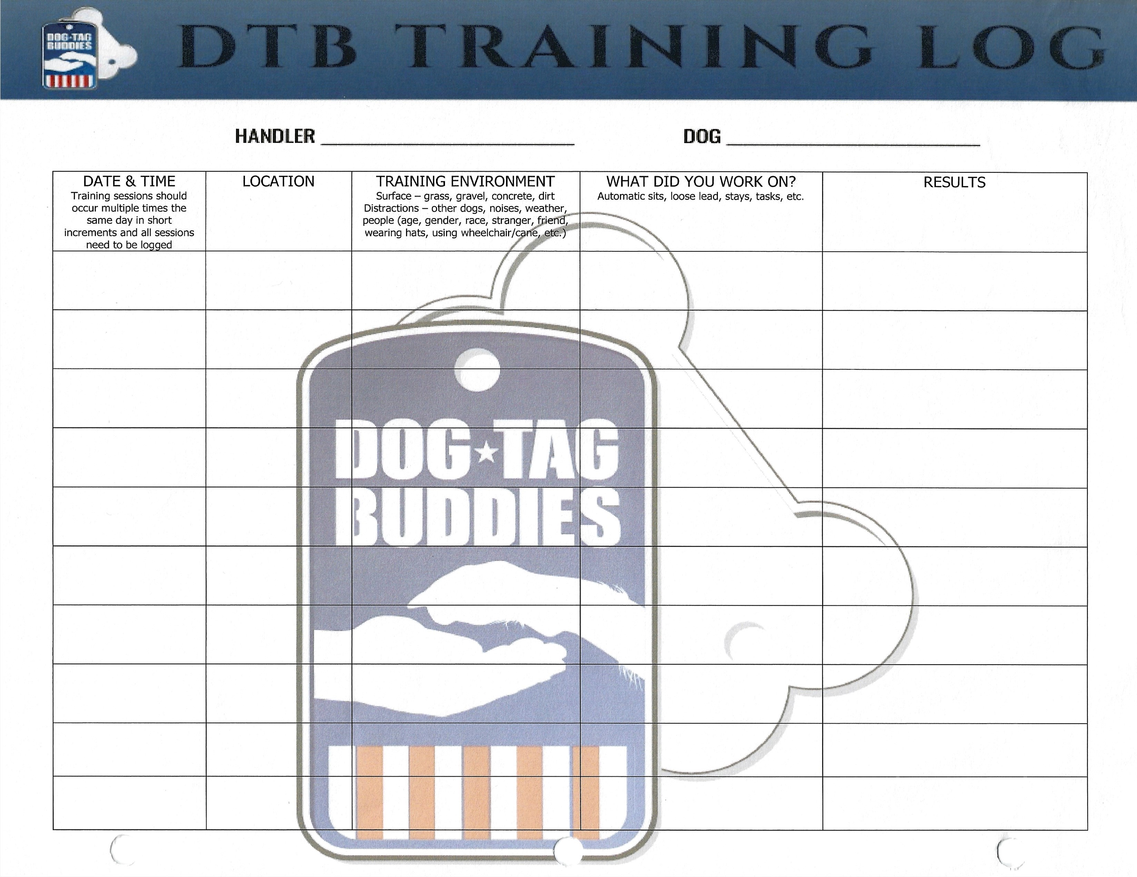
Physical VS Electronic
Easy to have on the go.
Easy to use interface.
Keeping records for trainer and instructors.
Trainers are more likely to record every training event big or small.

Slide 6
Development
Development
How to Implement
Unit Testing
Decided the goal for the application
Coding to solve the task
Insuring code handles every interaction the user has with the application

Slide 7
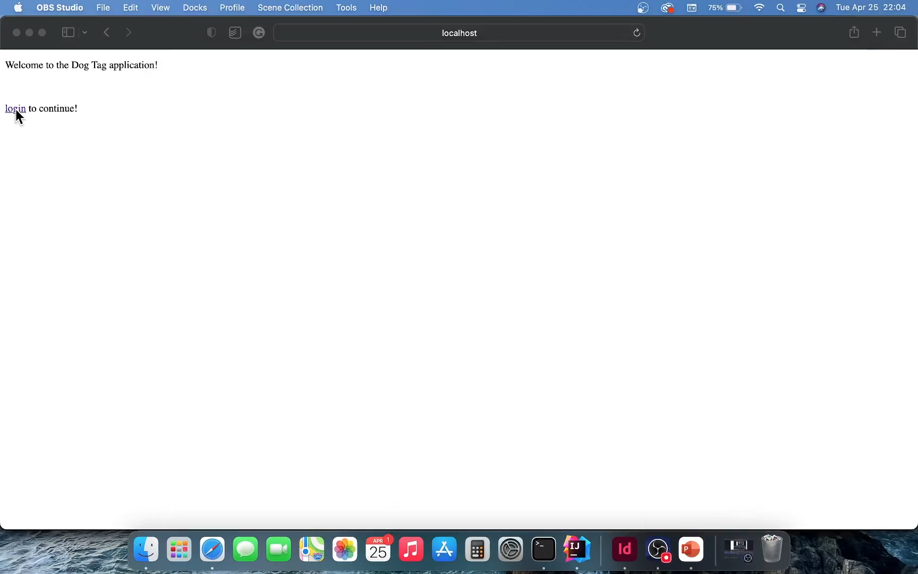
Login
Handles Short Entry’s
Wrong Entered Information
Blank Entry's
All With User Feedback

Slide 8
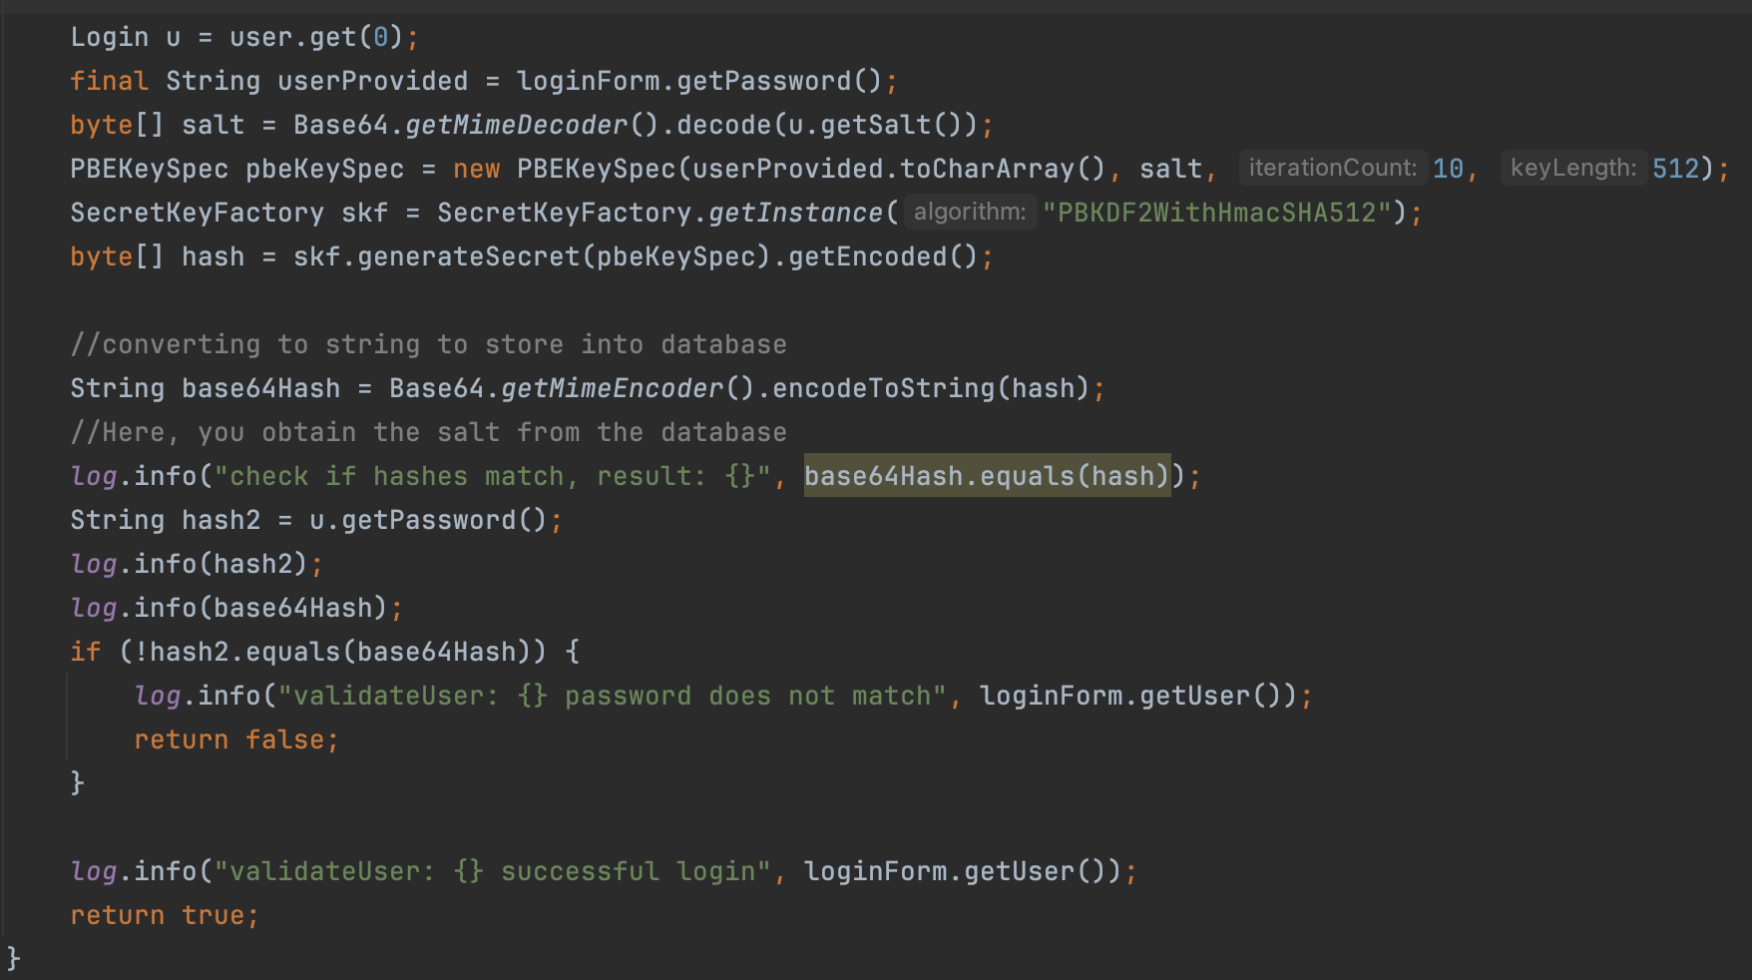
Password and User are valid when decoded and the hashes match

Slide 9
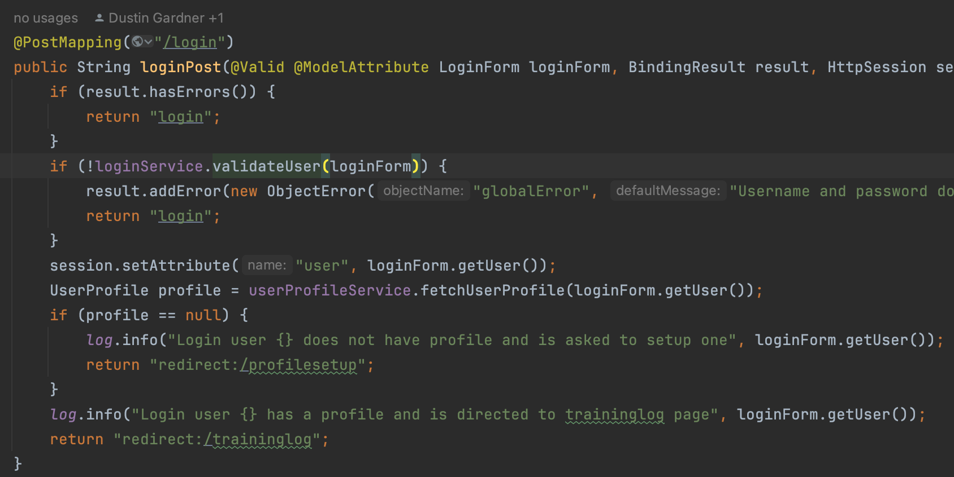
Checks to see if User has a profile set and redirects accordingly

Slide 10
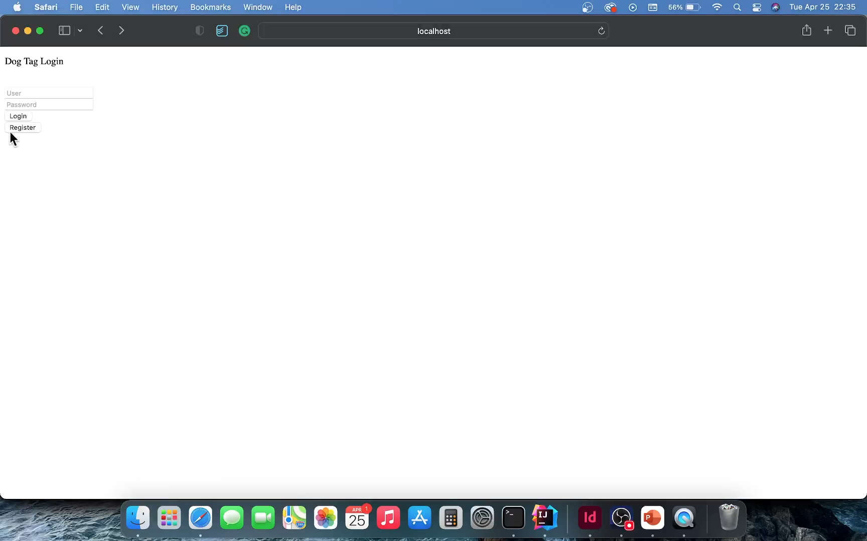
Register
Ensures User and Email can not be used again
Password and User Fields require a certain length
Requires User to register correctly
All With User Feedback
Email vaildation

Slide 11
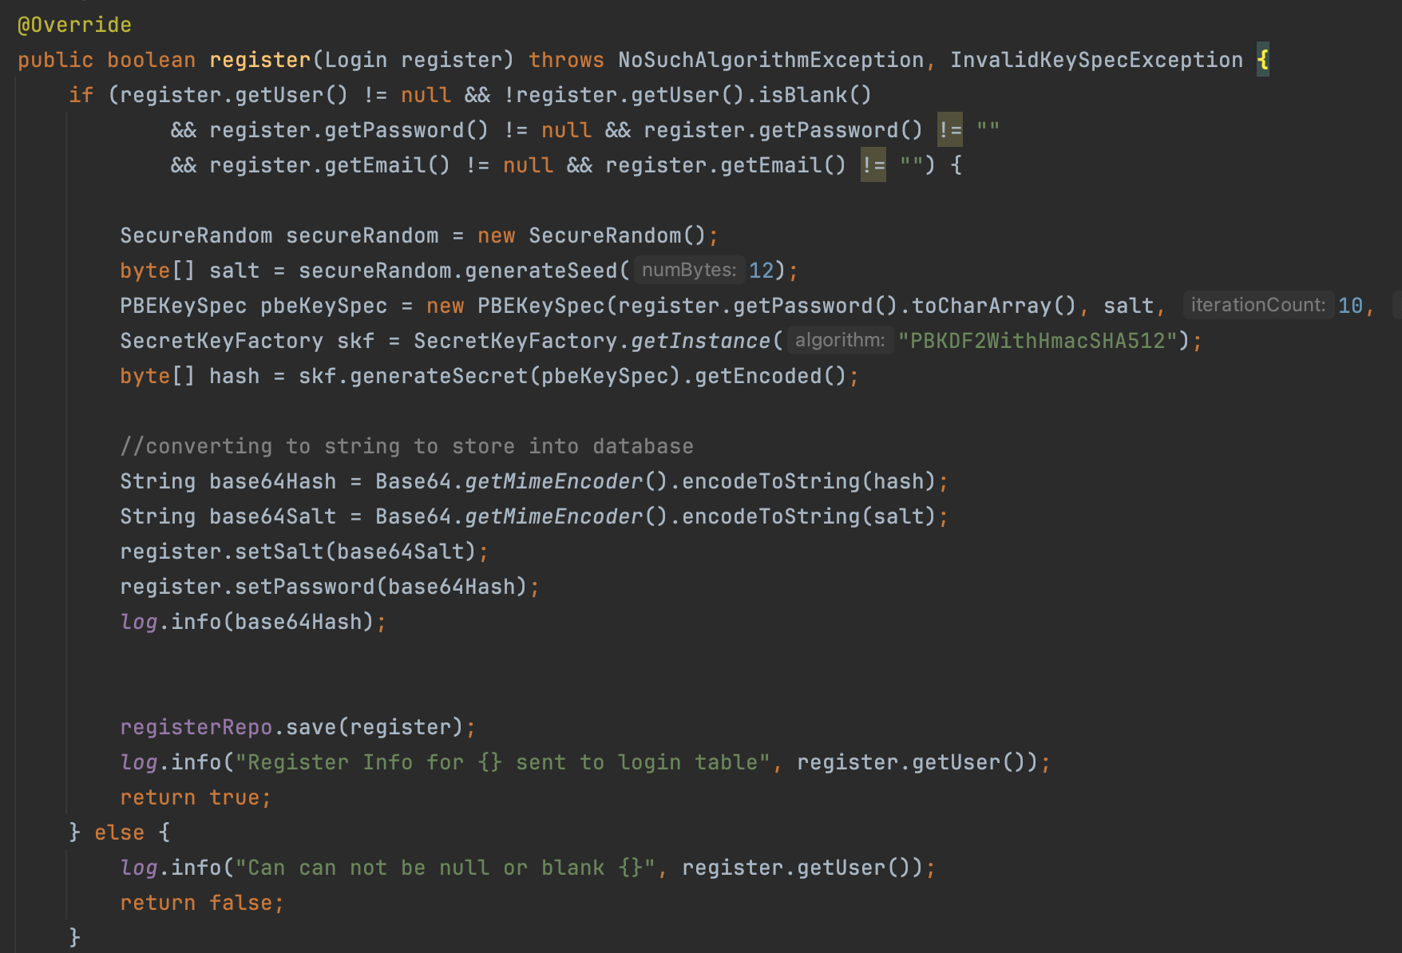
Password are being hash with random salt and both are saved in the database

Slide 12
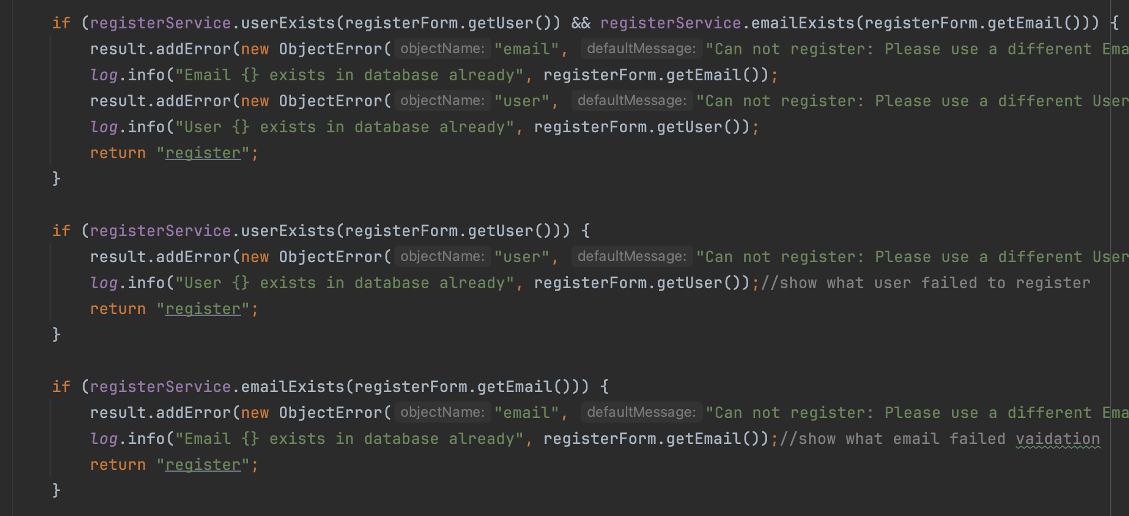
Important checks for registering a User

Slide 13
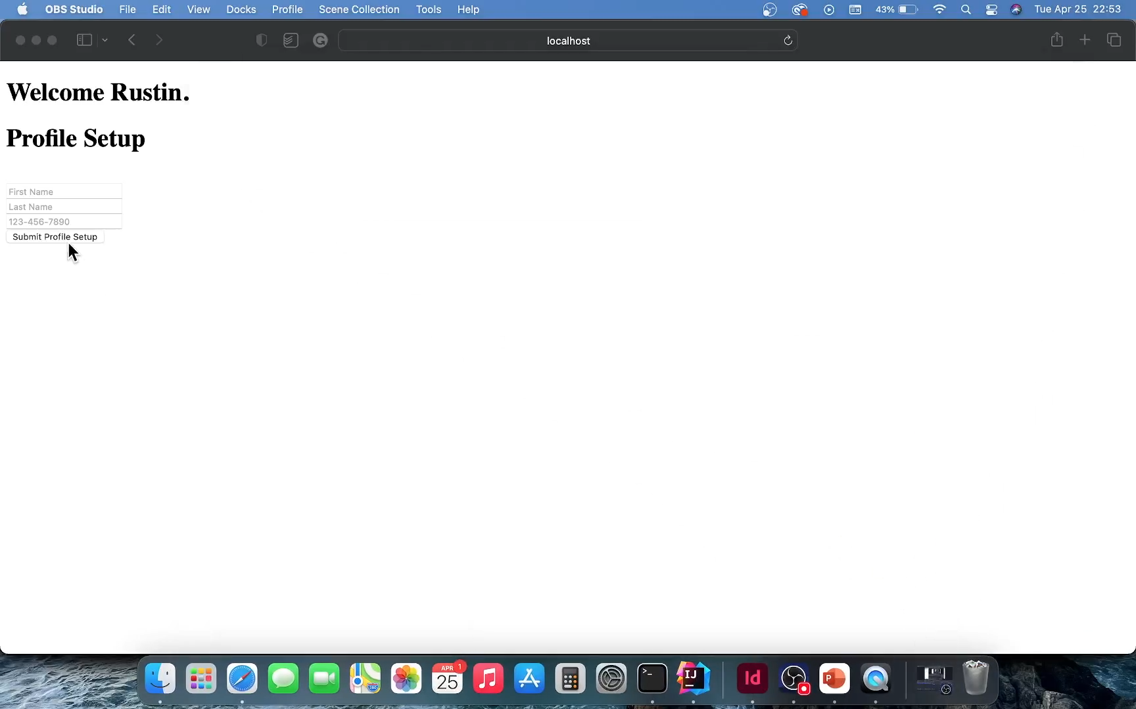
Profile
Setup
Directed to the Profile Setup
User has not setup profile
Selects to return from training logs.
All With User Feedback

Slide 14
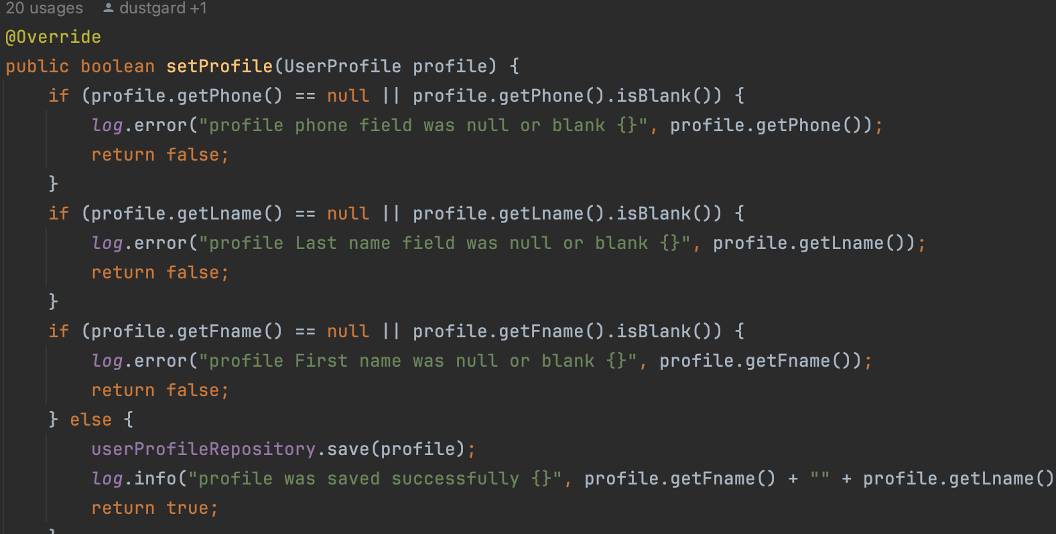
Will not save a null or blank profile.

Slide 15
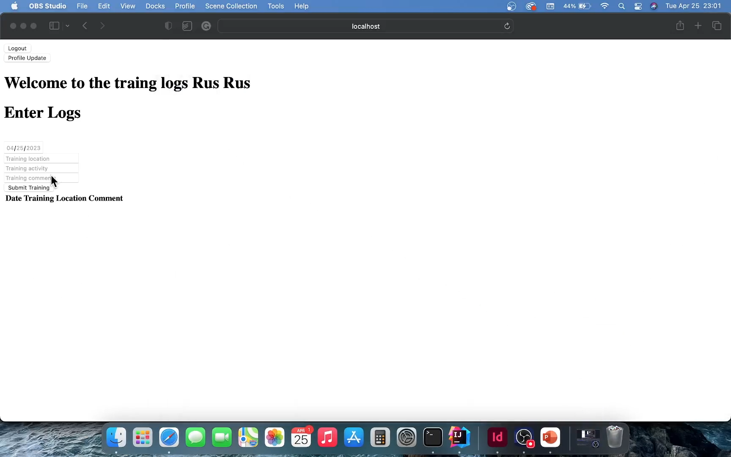
Training
Logs
Directed to the Training Logs
User has setup profile
Ensures Training Logs are entered correctly
All With User Feedback
Data is persistent per user

Slide 16
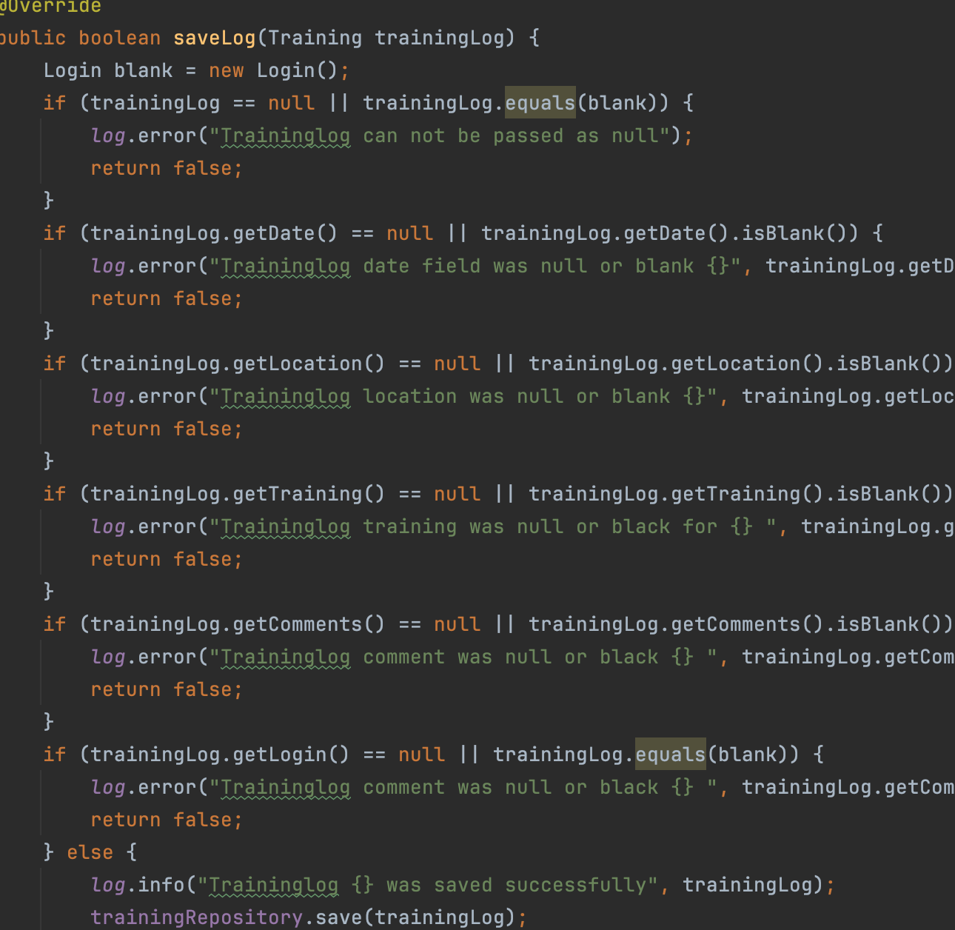
Will not save a null or blank training log.
Unit Test uncovered this need

Slide 17
Binding Result
BindingResult holds the result of a validation and binding
The BindingResult must come right after the model object
Spring fails to validate the object and throws an exception.
Order
Validation
Form Annotation

Slide 18
Model And View
ModelAndView is a value object designed to hold model and view
This makes it possible to return both model and view in a single return value.
Why I went back to Model
Easier to break down the process
Trouble with the Post Mapping

Slide 19
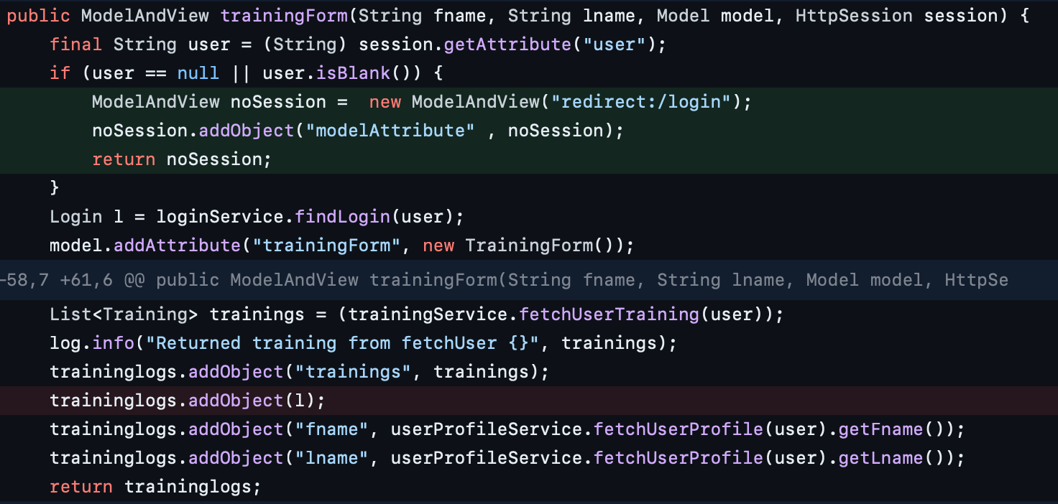

Slide 20
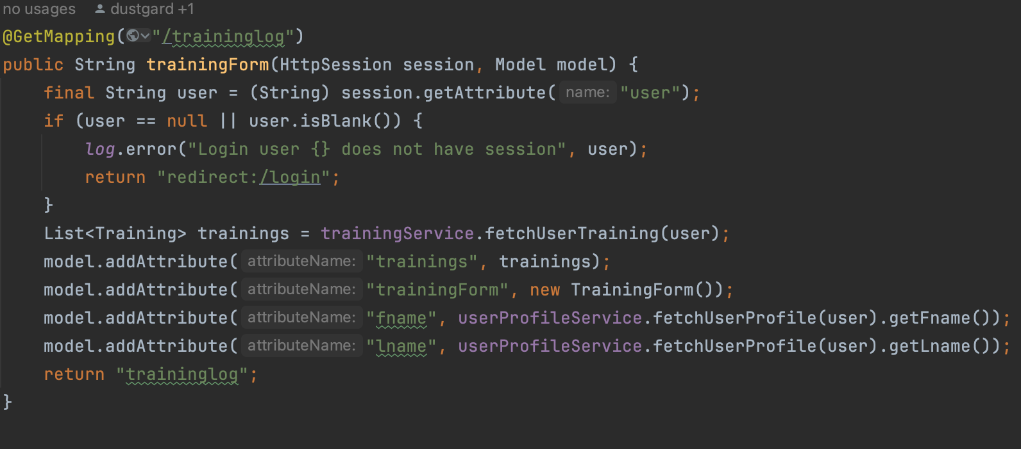

Slide 21
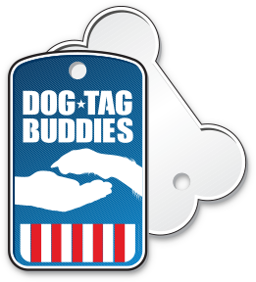
Future Implementation
Instructor Training assignments
Training Videos
Scheduled Dog Maintenance
Vaccination Reminders
Checklist of mastered dog tasks
Certification records

Slide 22
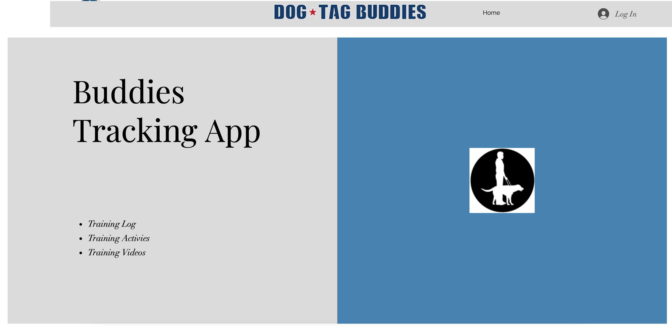
Site Improvements

